Slide 1
Things We Love About Unix
Alan Dewar, Senior Staff Engineer, Synopsys
2024-02-27

Slide 2
Outline
History
Philosophy
OS Comparisons
Features
Your Views

Slide 3
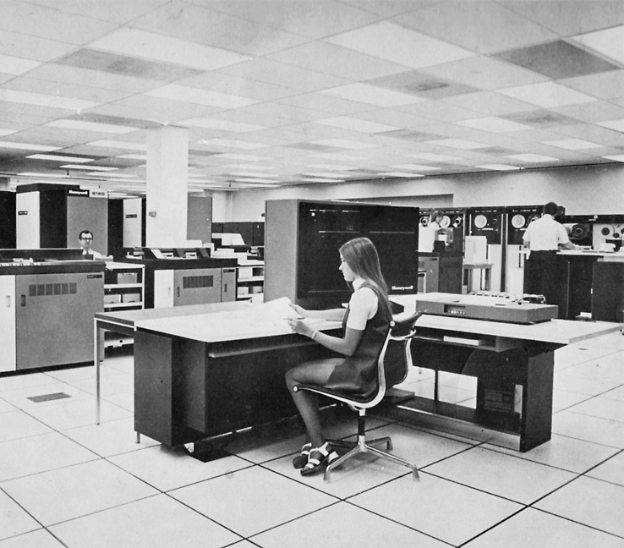
History
Multics
Multiplexed Information and Computing Service
1964: initial planning, development
MIT, General Electric, Bell Labs
Designed for security
Time sharing
Dynamic linking
Hierarchical file system
User-level command processor
High-level systems language (PL/I)
Active functions

Slide 4
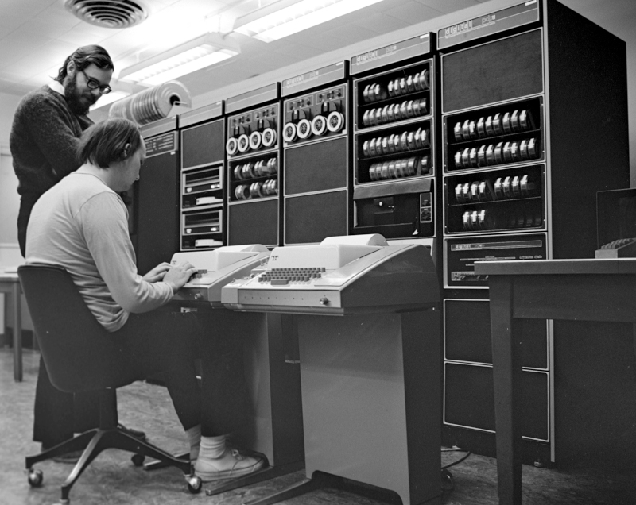
History
Unix
Originally Unics
  Uniplexed Information and Computing Service
Bell Labs withdraws from Multics
Ken Thompson
  Space Travel program
  Operating system design
Dennis Ritchie
  C
Doug McIlroy
  Pipes
  Various Unix tools
  Manual

Slide 5

History
Initial Distribution
AT&T antitrust consent decree (1954)
  Not allowed to enter computer business
  Required to license non-telephone technology
CACM paper (1974)
High demand from universities and research labs

Slide 6
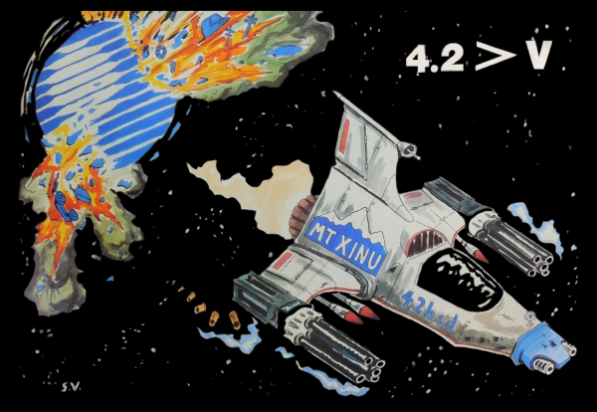
History
Unix Wars

Slide 7
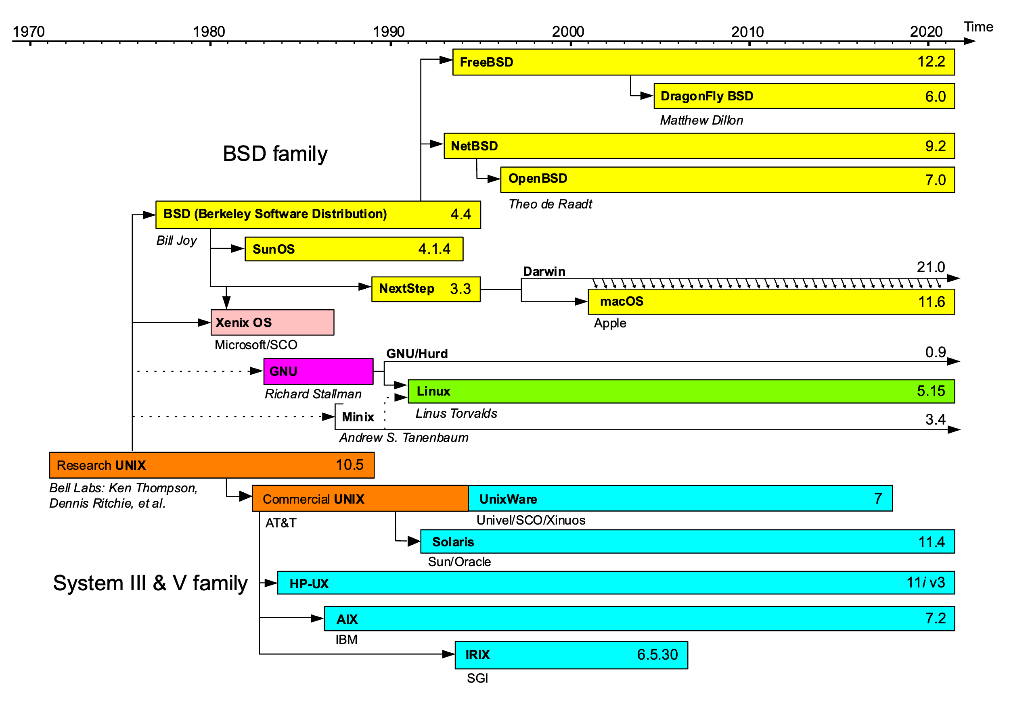
History
Unix Wars

Slide 8
History
Unix Wars
Berkeley Software Distribution (BSD)
  Computer Systems Research Group (CSRG) at the University of California, Berkeley
  Based on the original Unix source code
  Ken Thompson 1975 sabbatical as visiting professor
Bell System antitrust break-up
  Unix System V
Productization, differentiation lead to end of sharing
Richard Stallman
  Free Software Foundation, GNU manifesto
1985: POSIX standards (IEEE)
Larry Wall
  patch, perl

Slide 9

Modern Unix
*BSD
macOS
Linux
Solaris
HP-UX
AIX
Windows
  Windows Subsystem for Linux (WSL)
  cygwin
  RMS: “a step backward in the campaign for freedom”

Slide 10

Calgary Unix Users’ Group (CUUG)
Early Diamond Sponsors
  DEC (Digital UNIX)
  HP (HP-UX)
  IBM (AIX)
  Sun (SunOS, Solaris)
Open Systems
  Linux
  OpenBSD

Slide 11
What’s in a Name?
UNIX
  Trademark
    AT&T -> Novell -> The Open Group
  Single Unix Specification (SUS)
    Extends POSIX
Unix
  Generic term
GNU
  GNU’s Not Unix
Linux
  GNU/Linux

Slide 12
Unix Philosophy
Doug McIlroy: Bell System Technical Journal, 1978
Make each program do one thing well.
  To do a new job, build afresh rather than complicate old programs by adding new “features”.
Expect the output of every program to become the input to another, as yet unknown, program.
  Don't clutter output with extraneous information. Avoid stringently columnar or binary input formats. Don’t insist on interactive input.
Design and build software, even operating systems, to be tried early, ideally within weeks.
  Don’t hesitate to throw away the clumsy parts and rebuild them.
Use tools in preference to unskilled help to lighten a programming task,
  even if you have to detour to build the tools and expect to throw some of them out after you’ve finished using them.

Slide 13
Unix Philosophy
Doug McIlroy: Summarizing
Write programs that do one thing and do it well.
Write programs to work together.
Write programs to handle text streams, because that is a universal interface.

Slide 14
Unix Philosophy
Ritchie and Thompson: CACM, 1974
Make it easy to write, test, and run programs
Interactive use instead of batch processing
Economy and elegance of design due to size constraints (“salvation through suffering”)
Self-supporting system: all Unix software is maintained under Unix

Slide 15
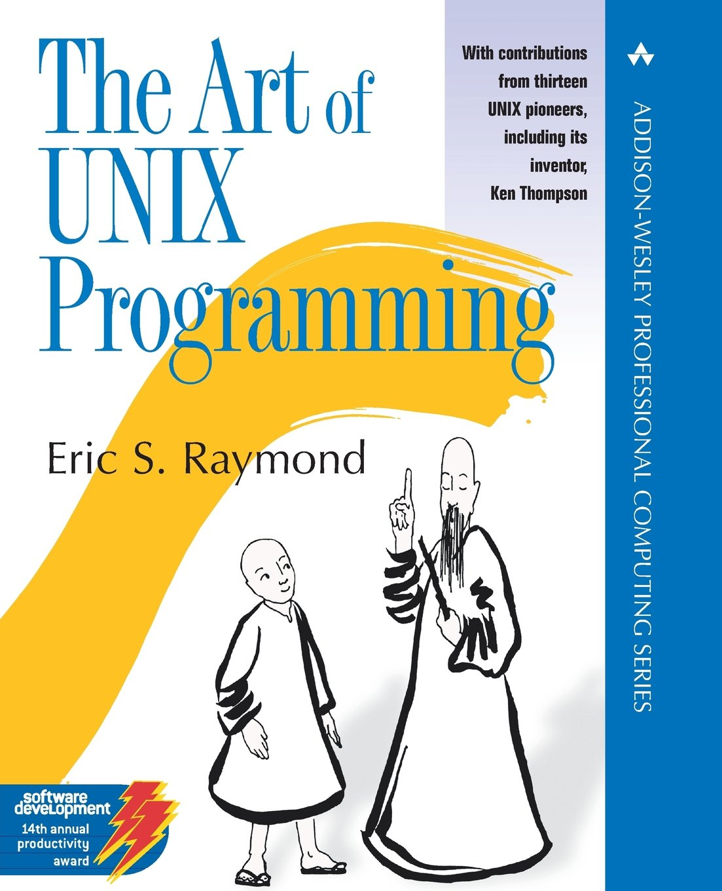
Unix Philosophy
Eric S. Raymond: The Art of UNIX Programming
Build modular programs
Write readable programs
Use composition
Separate mechanisms from policy
Write simple programs
Write small programs
Write transparent programs
Write robust programs
Make data complicated when required, not the program
Build on potential users’ expected knowledge
Avoid unnecessary output
Write programs which fail in a way that is easy to diagnose
Value developer time over machine time
Write abstract programs that generate code instead of writing code by hand
Prototype software before polishing it
Write flexible and open programs
Make the program and protocols extensible

Slide 16
OS Comparisons
MacOS (pre-MacOS X)
Desktop focus
Single user
Cooperative multi-tasking
Single address space

Slide 17
OS Comparisons
MacOS X
Based on BSD Unix

Slide 18
OS Comparisons
OS/2
Single user
Pre-emptive multi-tasking

Slide 19
OS Comparisons
Microsoft: DOS, 3.1, 95, NT, 2000, XP, Server 2003, …
Pre-emptive multi-tasking
Expensive spawn
Special-purpose programs for documents, databases
Registry
Incompatible changes
Backward-compatibility -> loose security
DLL hell
Unifying metaphor: “The customer must be locked in”

Slide 20
OS Comparisons
BeOS
POSIX
Initially specific hardware
Lost to Microsoft anti-competitive actions and to Linux

Slide 21
OS Comparisons
MVS
IBM mainframe batch processing
JCL
EBCDIC
SUS

Slide 22
OS Comparisons
VM/CMS
IBM
Hosts many virtual machines

Slide 23
OS Comparisons
Linux
Ease of install
Dual-boot
Other file systems

Slide 24
OS Comparisons
Solaris, AIX, HP-UX
$$$

Slide 25
Unix Features
Ecosystem
Multi-platform
  Especially including inexpensive personal hardware
Free
Open
Stable
Scalable
Community support
Programming tools
Customizable
Secure
  Some more so than others

Slide 26
Unix Features
Technical
Shell
Scripting
Everything is a file
Networking
Multiple privilege groups
Multi-tasking
Time sharing
Inter-Process Communication (IPC)

Slide 27
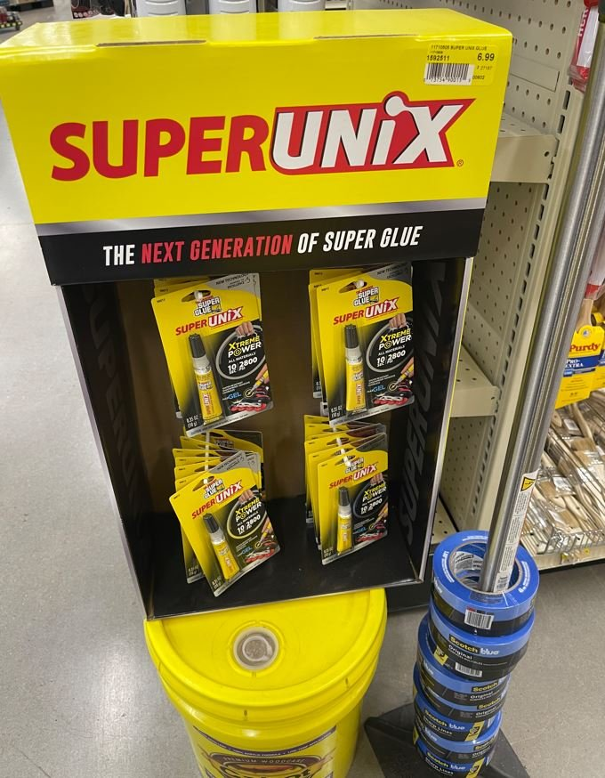
Other UNIX

Slide 28

What Do You Love About Unix?
Image: https://geekfamilylife.com/valentines-day-tutorial-linux-administrator-life/

Slide 29
References
https://multicians.org/
https://en.wikipedia.org/wiki/Ken_Thompson
https://en.wikipedia.org/wiki/Dennis_Ritchie
https://en.wikipedia.org/wiki/Douglas_McIlroy
https://en.wikipedia.org/wiki/Unix_wars
https://en.wikipedia.org/wiki/Windows_Subsystem_for_Linux
https://en.wikipedia.org/wiki/Unix_philosophy
http://www.catb.org/esr/writings/taoup/html/

